Slide 1
Team Scorpion
Presents
Anime Recommendation System

Slide 2

Hello!
I am Rahul Mondal
I will be guiding you through the data analysis and our project today!
Have fun ;)

Slide 3






Team Members
Balaji S
Dishan DA
S Naveen
S Simha
S Justin
Akshat Singh

Slide 4
What is Anime?
In its most basic form, anime refers to animation. Interestingly enough, the name itself isn’t an abbreviation of the English word animation. Instead, it’s how you say “animated Show” in Japanese. To a Japanese viewer, anime is any cartoon, whether it’s made in Japan or not. Outside of Japan, however, the term anime has come to mean “animation made in Japan,” or more broadly, any animated show or movie that uses signature aspects of Japanese-style animation, like vibrant colors, dramatic panning, and characteristic facial expressions

Slide 5
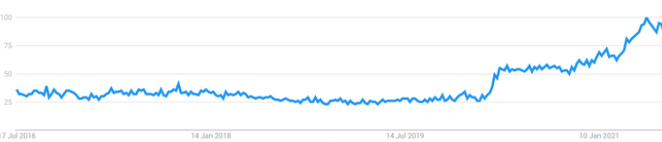
The Popularity of Anime 2016-2021

Slide 6
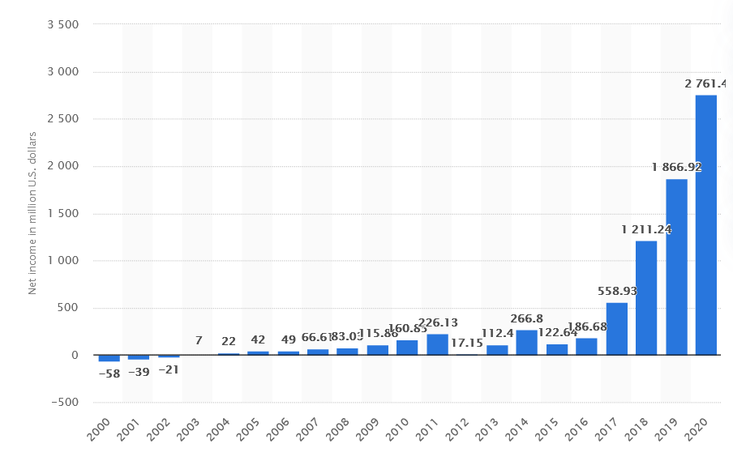
Profits Of Netflix (in million USD)
Source :- https://www.statista.com/statistics/272561/netflix-net-income/

Slide 7
Project Summary
Anime Recommendation for the Users:
Recommended them the shows based on their age.
Based on the Content Based Filtering Approach
Based on the genre
Based on the similarities of anime
How’s it helpful for the Anime Makers:
Anime Makers can see which animes is watched more and know which type of anime people would they really love to watch next.
Which will get more viewers
This increases profit for them as well as the website using this system..
Makers can get an idea about what type of anime is popular and they can release the next season accordingly.

Slide 8
Purpose of our project
What is the actual driving force behind the creation of this project fIrstly?
There are thousands of movies and shows, it would be hard to figure out what to watch or what should watch next this is why recommendations are so useful .
Use this information to build a better anime recommended system.
It provides personalized recommendation for the users.

Slide 9
Inside the dataset
GENRE
Genre of the anime
AGE
Age of the user
RATING
Anime’s Rating
EPISODES
Number of episodes in the anime
TYPE
Type: OVA, Movie, Series
VIEWS
Number of viewers

Slide 10
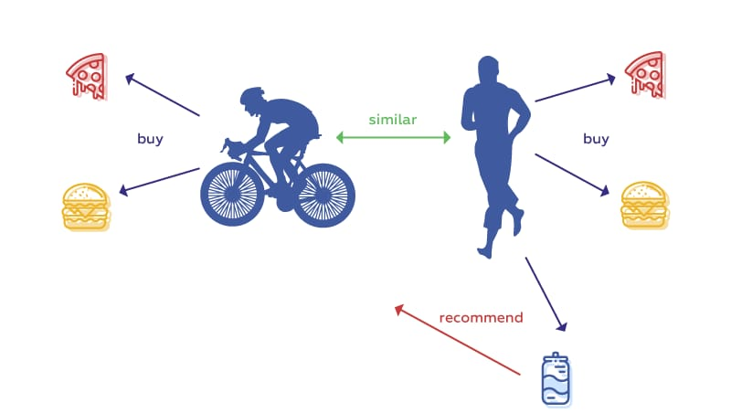
Recommendation System Works on the basis on similarities.The Photo shows the details of it:
Here both Person-1 and Person-2 buys two similar products, later person1 buys another product. The system recommends the same product to Person-2 as both of them have bought the similar products previously.
Working Principles

Slide 11
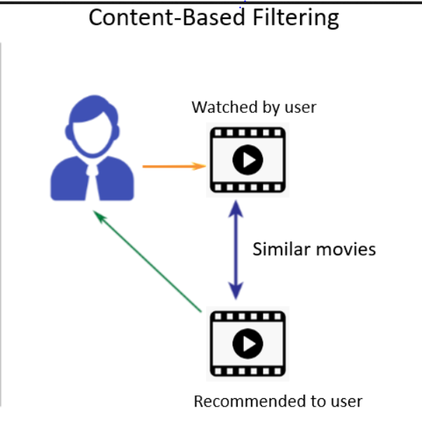
Content Based Filtering
Content-based Filtering is a Machine Learning technique that uses similarities in features to make decisions. This technique is used in our recommender system

Slide 12
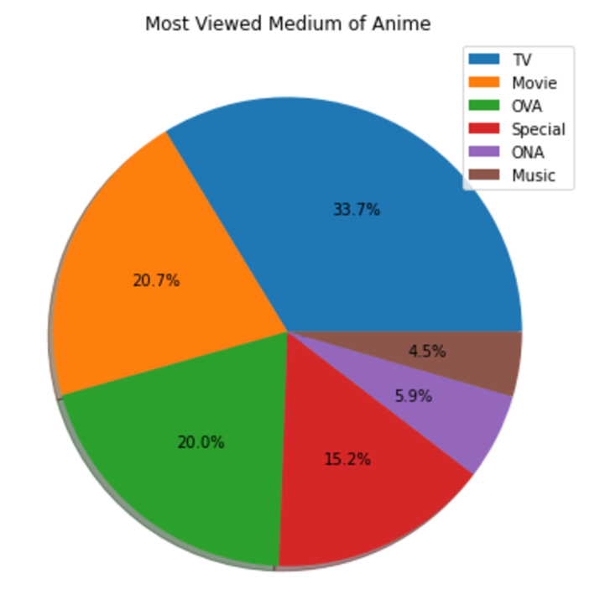
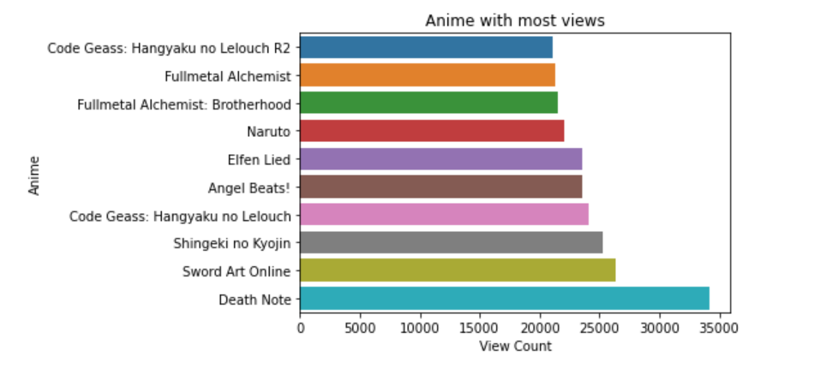
Lets look at some insights from this dataset

Slide 13
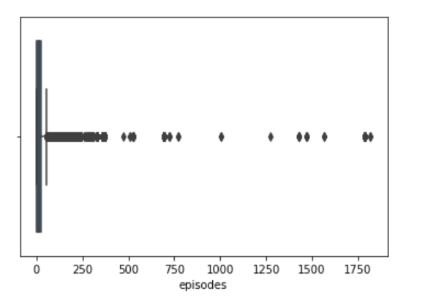
Number of episodes

Slide 14
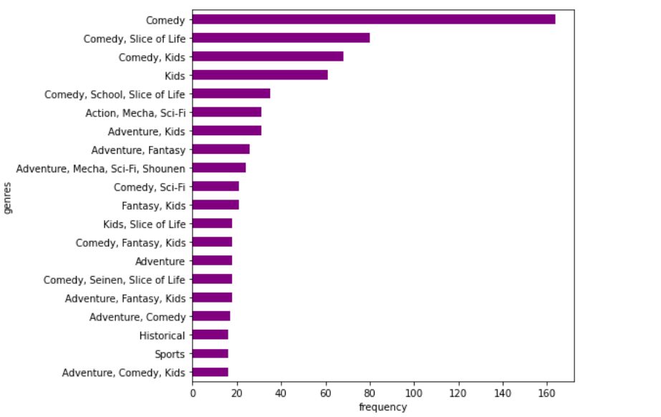
Genre of TV Anime

Slide 15
Ideas behind the working of this project
Load and clean the dataset
Our target variable is the genre so we shall convert them into 1 and 0
Make predictions using the dataset and user’s input
Fit the dataset into K-nearest neighbors(KNN)

Slide 16
Roadmap
After facing a lot of issues like system crash, poor model performance and slow training times, we decided to do our research and come up with a working model that's easy on our system and quick as well
We decided to build something that is useful in daily life
We gave our best shot to build something similar to that and decided to make an anime
Recommendation system
1
3
5
2
4
6
We were surfing on youtube and we were fascinated by the accurate video recommendations given to us
We searched for a trustworthy source of datasets and found a good one on kaggle
So we chose content based filtering approach and kNN algorithm to make this working model

Slide 17
Our process is easy(and comes with a kids filter too :)
1
2
3
Step 1
Step 2
Step 3
Load our model
Enter your Favourite Anime
Get Recommendations

Slide 18
Thanks!
Any questions?

